Slide 1
Sales Dataset Analysis – Advanced Excel Project
NAME:LOGESH.R
COURSE:DA&DS

Slide 2
PROJECT OBJECTIVES:
This project focuses on analyzing a comprehensive Sales Dataset using Excel to extract valuable insights that can aid in making data-driven business decisions. The dataset Includes key metrics such as sales, discounts, revenue, and sales channels.
Determine the impact of returns and discounts.
Create a dynamic dashboard with key metrics.
Identify high-performing products and sales channels.

Slide 3
DATASET OVERVIEW:
It contains following rows :
1.Row ID 2.Order ID 3.Order Date 4.Ship Date 5.Ship Mode 6.CustomerID 7.CustomerName 8.Segment 9.Country 10.City
11.State 12.Postal Code 13.Region 14.ProductID 15.Category 16.Sub-Category 17.Product Name 18.Sales 19.Quantity 20.Discount 21.Profit

Slide 4
DATASET CLEANING PROCESS:
Removal of duplicates
Handling missing values
Data formatting
Data validation

Slide 5
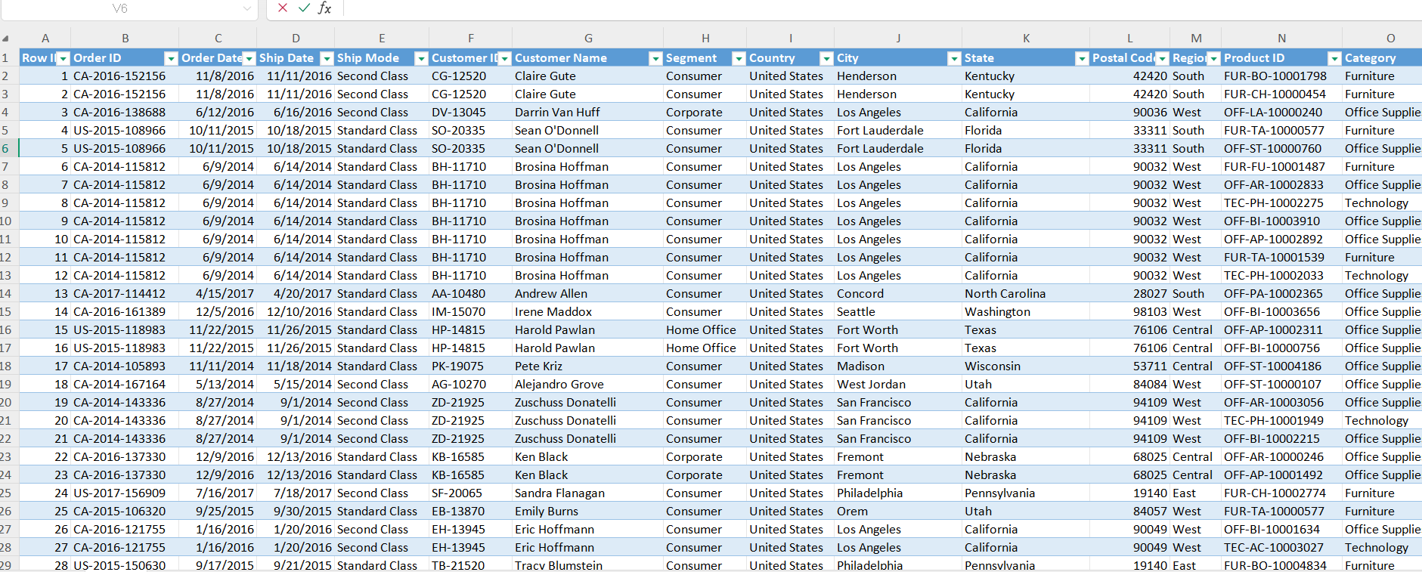
BEFORE CLEANING DATASET:

Slide 6
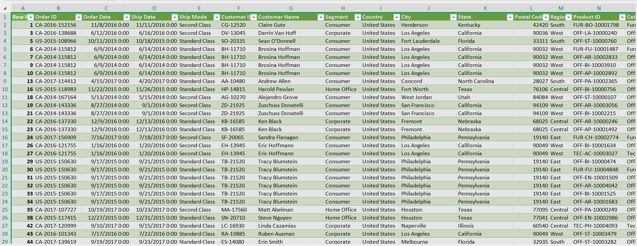
AFTER CLEANING DATASET

Slide 7
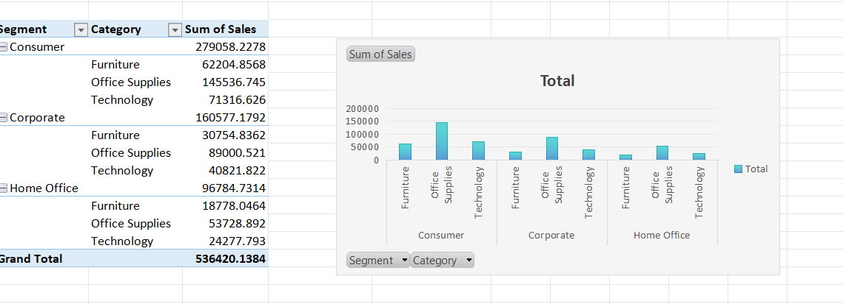
PIVOT TABLE AND PIVOT CHART

Slide 8
DASHBOARD OVERVIEW:
Dashboard is a visual representation of a data in the form of charts and graphs which are easier to analyze.
Dashboard can be interactive by applying the slicers.
By providing actionable insights at a glance, dashboards support faster and more informed decision-making.

Slide 9
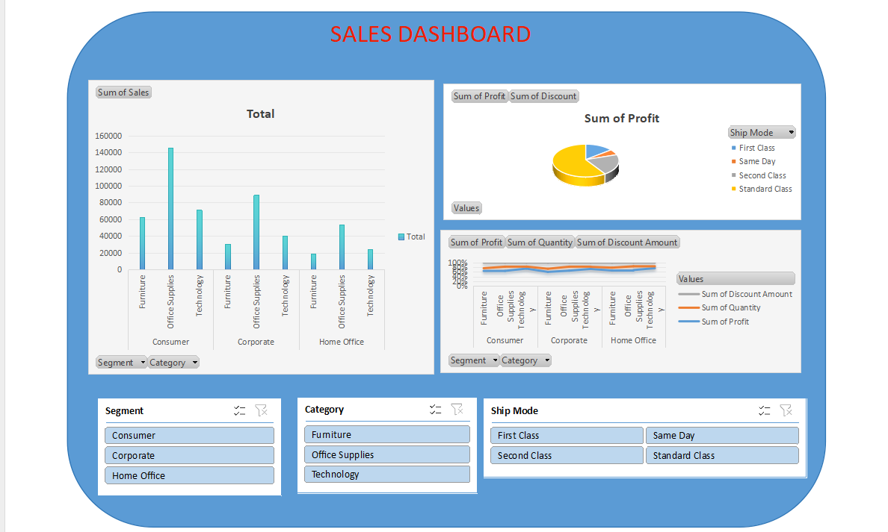
DASHBOARD:

Slide 10
CONCLUSION:
Trends in discounting and its impact on total sales.
Seasonal sales variations or peak performance times.
Recommendations for improving sales based on analysis
By optimizing the discount strategies we can increase the sales and once which are having the losses has to be improved either by quality or other constraints has to be considered

Slide 11
THANK YOU

